Slide 1
Dynamic Pricing Phase 2 KUT-LBP
E Yihang - LBP IT Team

Slide 2
Agenda
Topic | Duration
System Operation Process for LBPi portion | 45 Minutes
Questions | 10 Minutes

Slide 3

System Operation Process

Slide 4
Requirement Scope
# | Description
1 | Need new Pen-Rate delegation table in Admin Center
2 | Need new Pen-Rate Adjustment table in Admin Center
3 | Need Pen-Rate Priority Logic
4 | Pass Pen Rate information to LUDP/Magellan
  GEO: WW
  BU: ISG Only
  Quote type: LBPi (SC＆MC, Indirect＆Direct, Standard quote).​

Slide 5
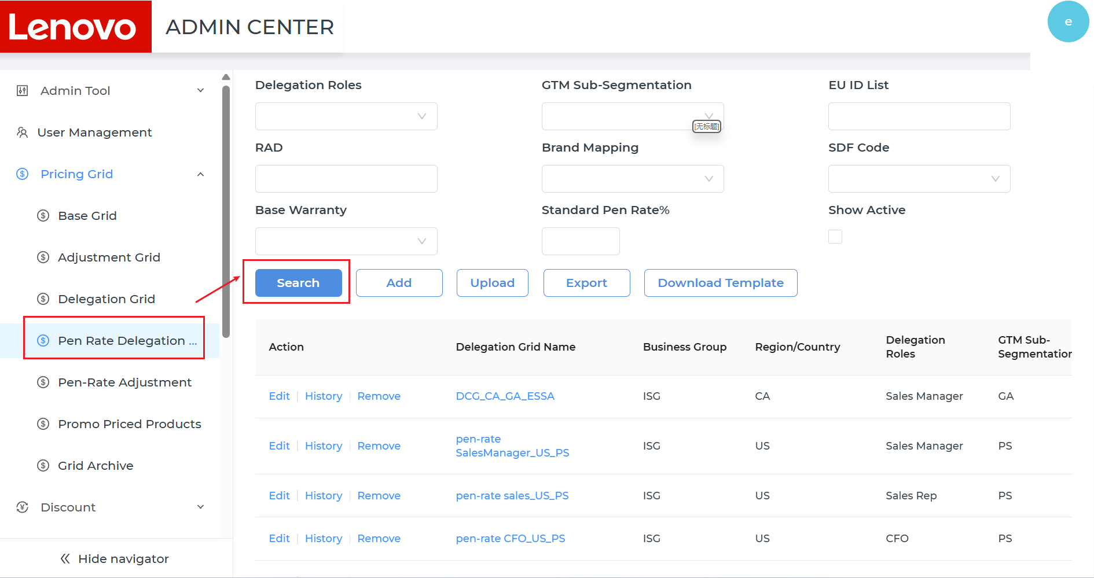
# | Story Number | Key Delivery
1 | DYPC2-3 | Need new Pen-Rate delegation table in Admin Center
1
Open LBP Admin, click Pricing Grid-Pen Rate Delegation table, user can check Pen Rate delegations.
Input/Select filters, click <Search> button, user can search delegations based on filters.
User can check the delegation list on the page.

Slide 6
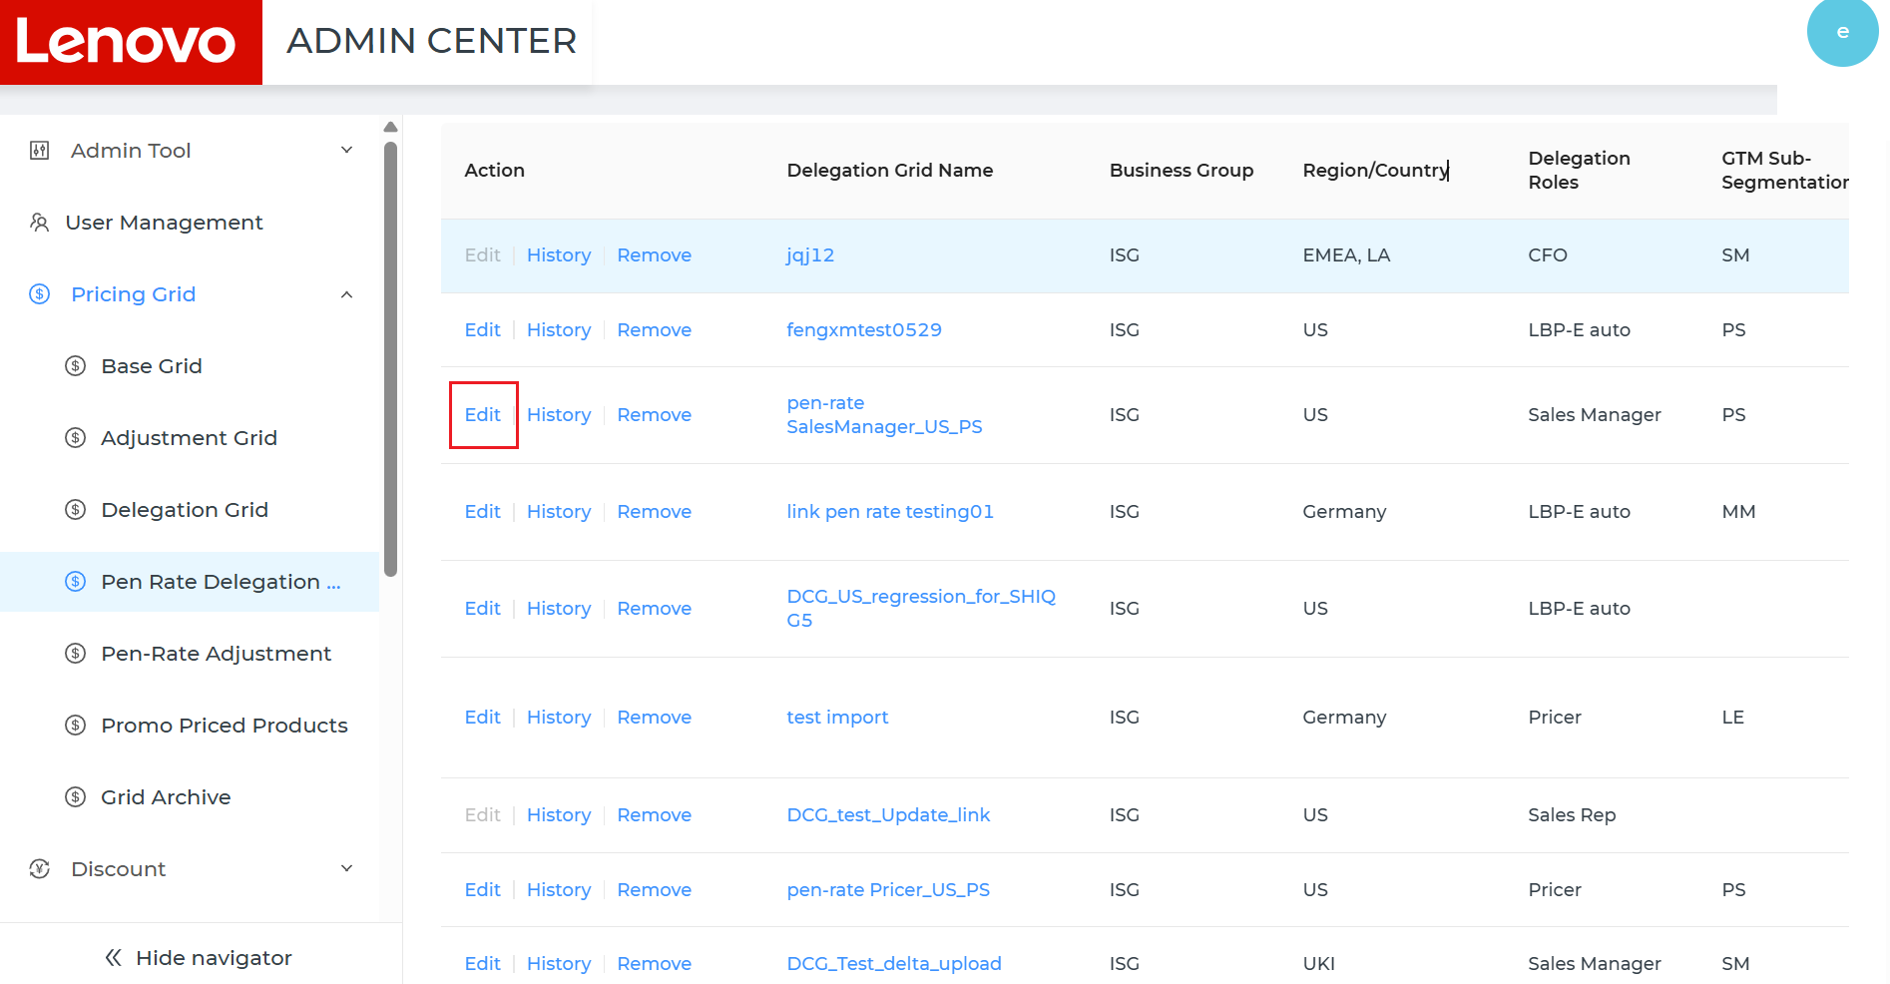
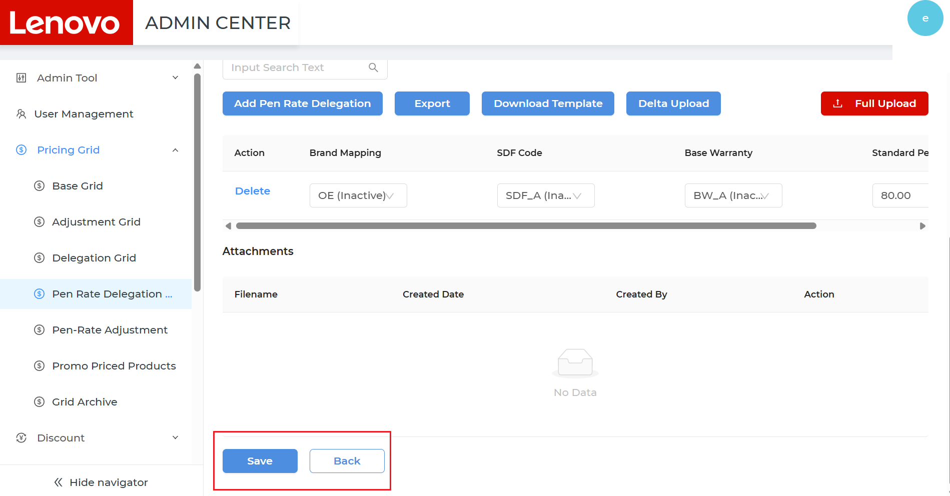
# | Story Number | Key Delivery
1 | DYPC2-3 | Need new Pen-Rate delegation table in Admin Center
2
Click <Edit> button on the line, it will jump to the delegation detail page, user can Edit the delegations on the page.
User can Edit the header information and the line information of the delegation.
Click <Save> button, the change will be saved and it will jump back to the delegation list page.
Click <Back> button, nothing will be changed and it will jump back to the delegation list page.

Slide 7
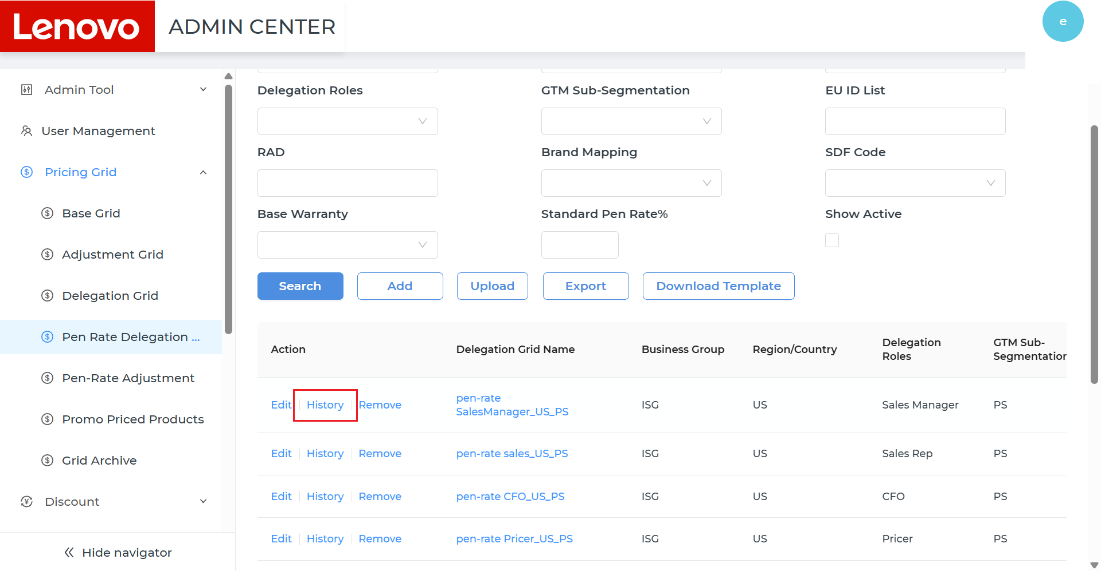
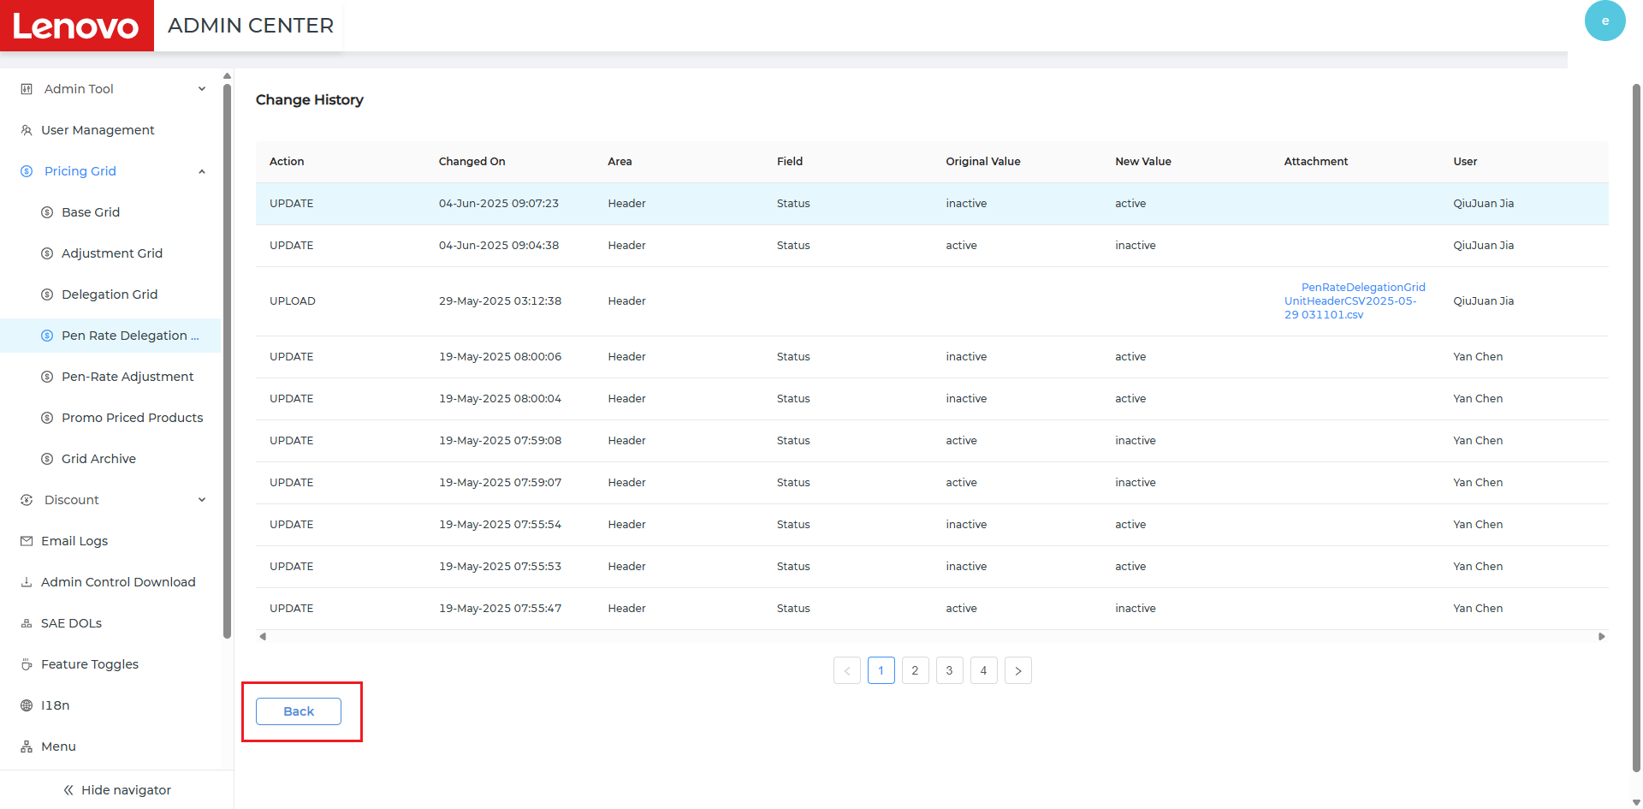
# | Story Number | Key Delivery
1 | DYPC2-3 | Need new Pen-Rate delegation table in Admin Center
3
Click <History> button on the line, it will jump to the history detail page, user can check the history of the delegation.
User can check the history by pages.
Click the hyperlink under the <Attachment> column, user can check the file details.

Slide 8
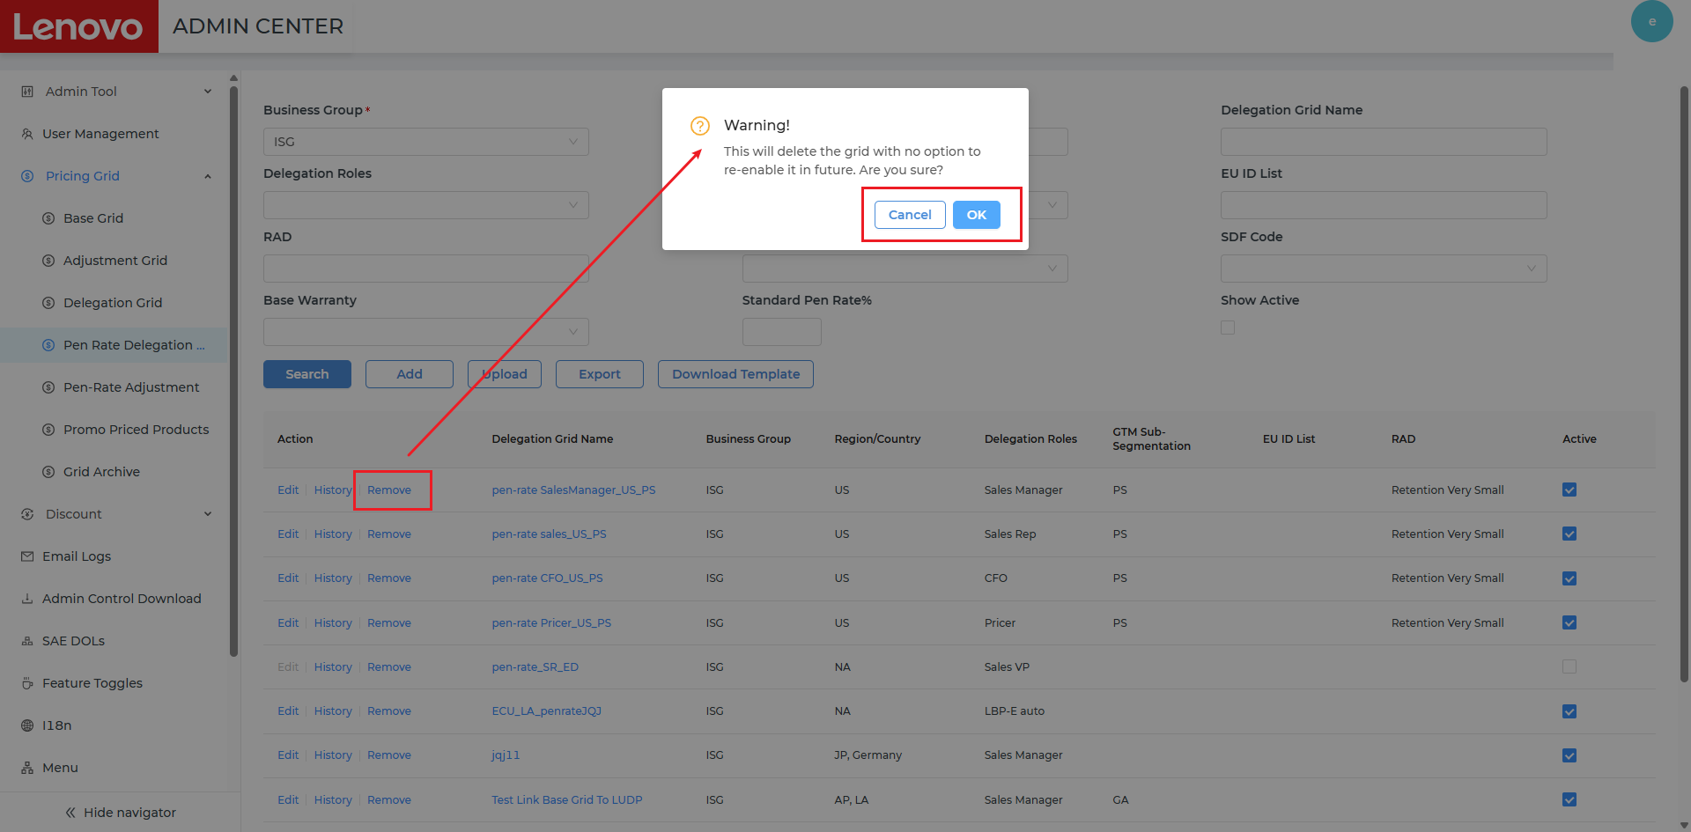
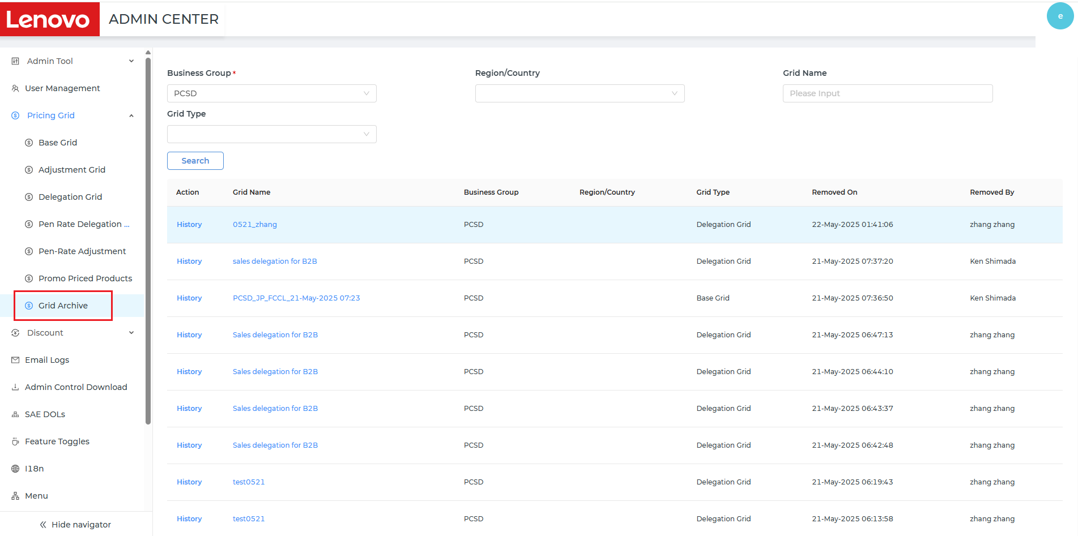
# | Story Number | Key Delivery
1 | DYPC2-3 | Need new Pen-Rate delegation table in Admin Center
4
Click <Remove> button on the line, user enable to remove the delegation.
System will pop up a warning message for double checking.
Click <Cancel> button in the pop-up, nothing will be changed and it will jump back to the delegation list page.
Click <OK> button, the delegation will be removed, user can check the removed delegation under <Grid Archive> table.

Slide 9
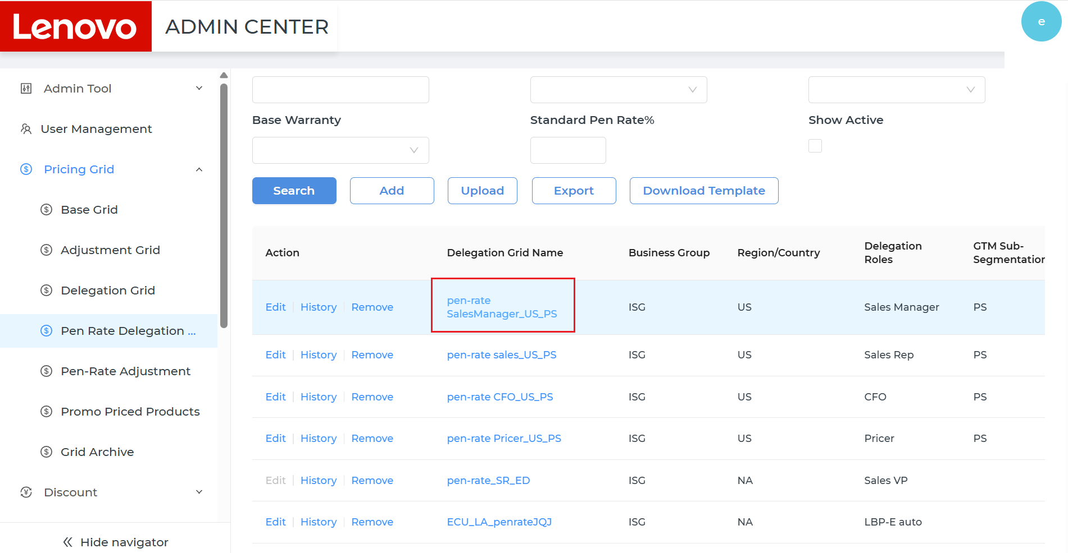
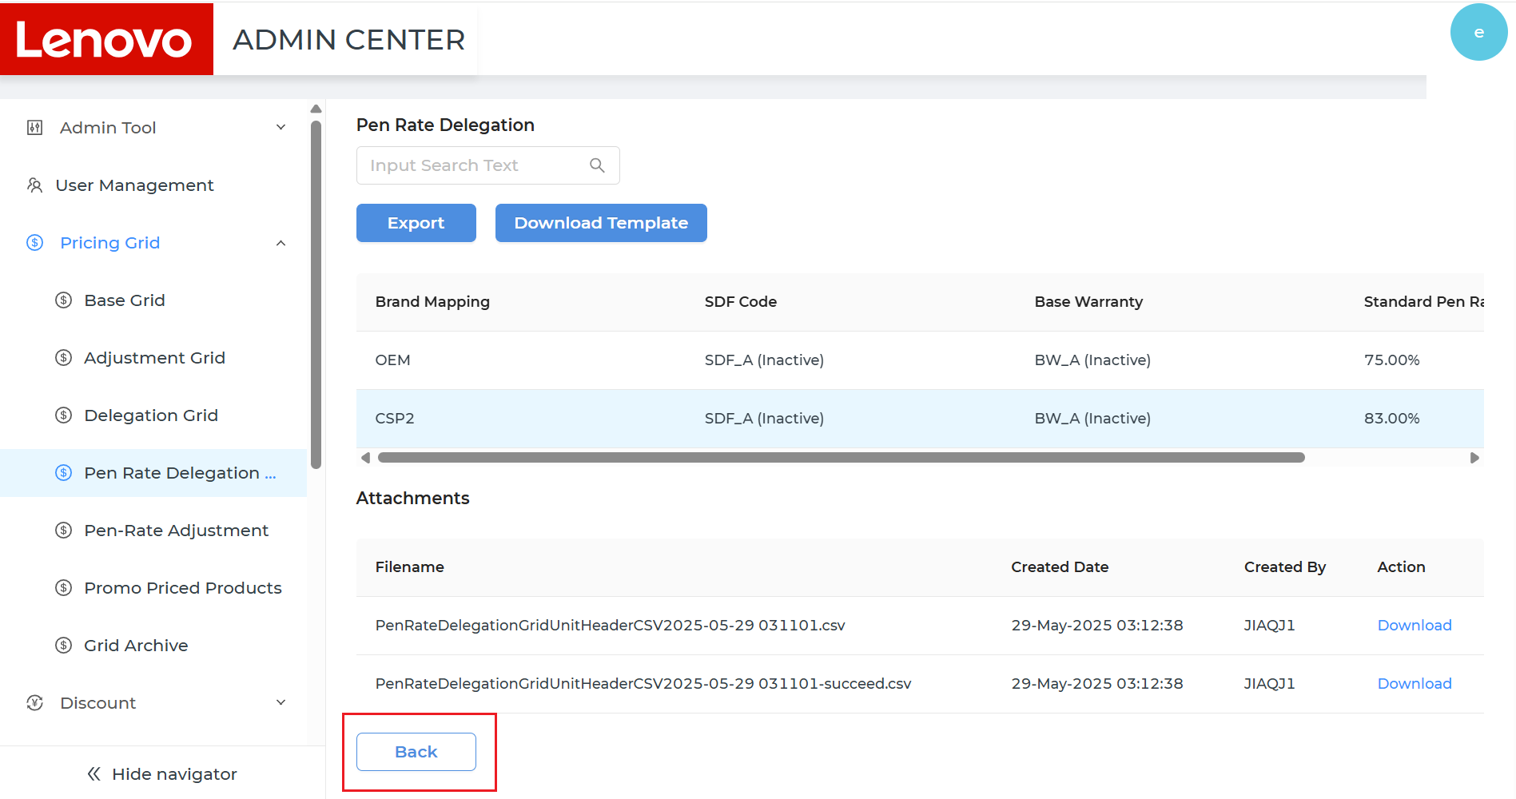
# | Story Number | Key Delivery
1 | DYPC2-3 | Need new Pen-Rate delegation table in Admin Center
5
Click the hyperlink of the Delegation Grid Name, it will enter the delegation detail page.
User can Export/Download Template the delegation information and Download the attachment file on the page.
Click <Back> button, it will jump back to the delegation list page.

Slide 10
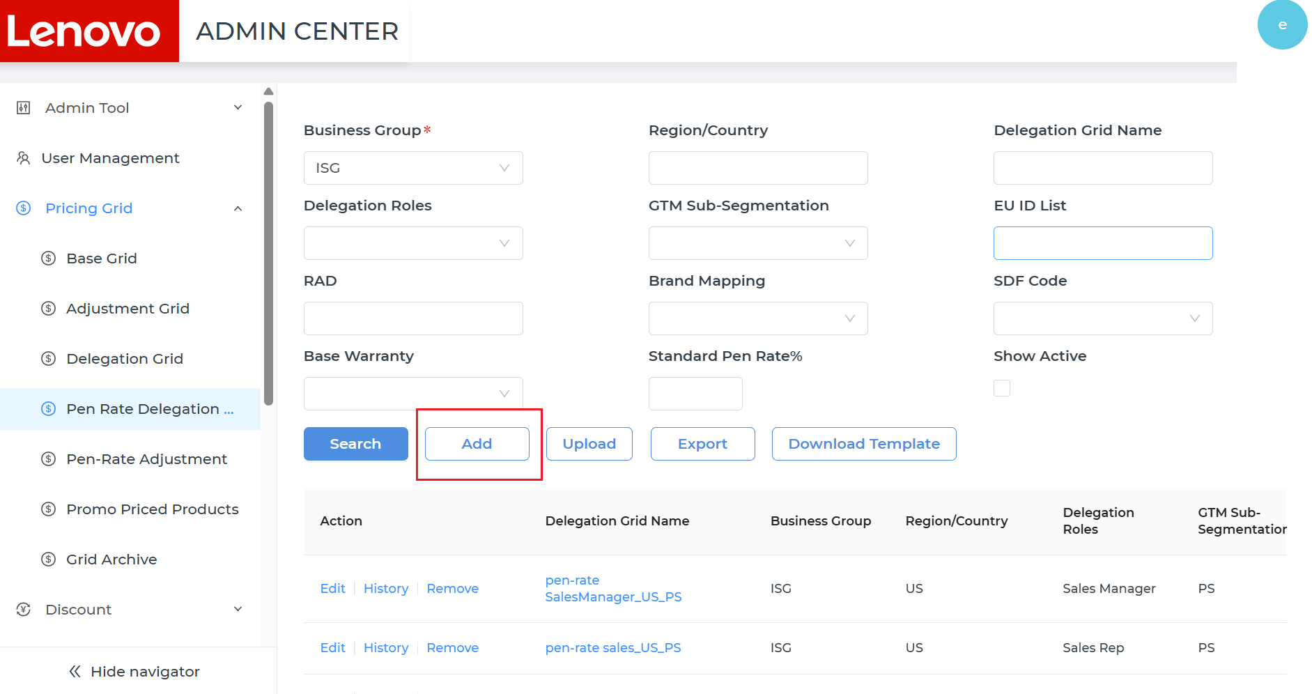
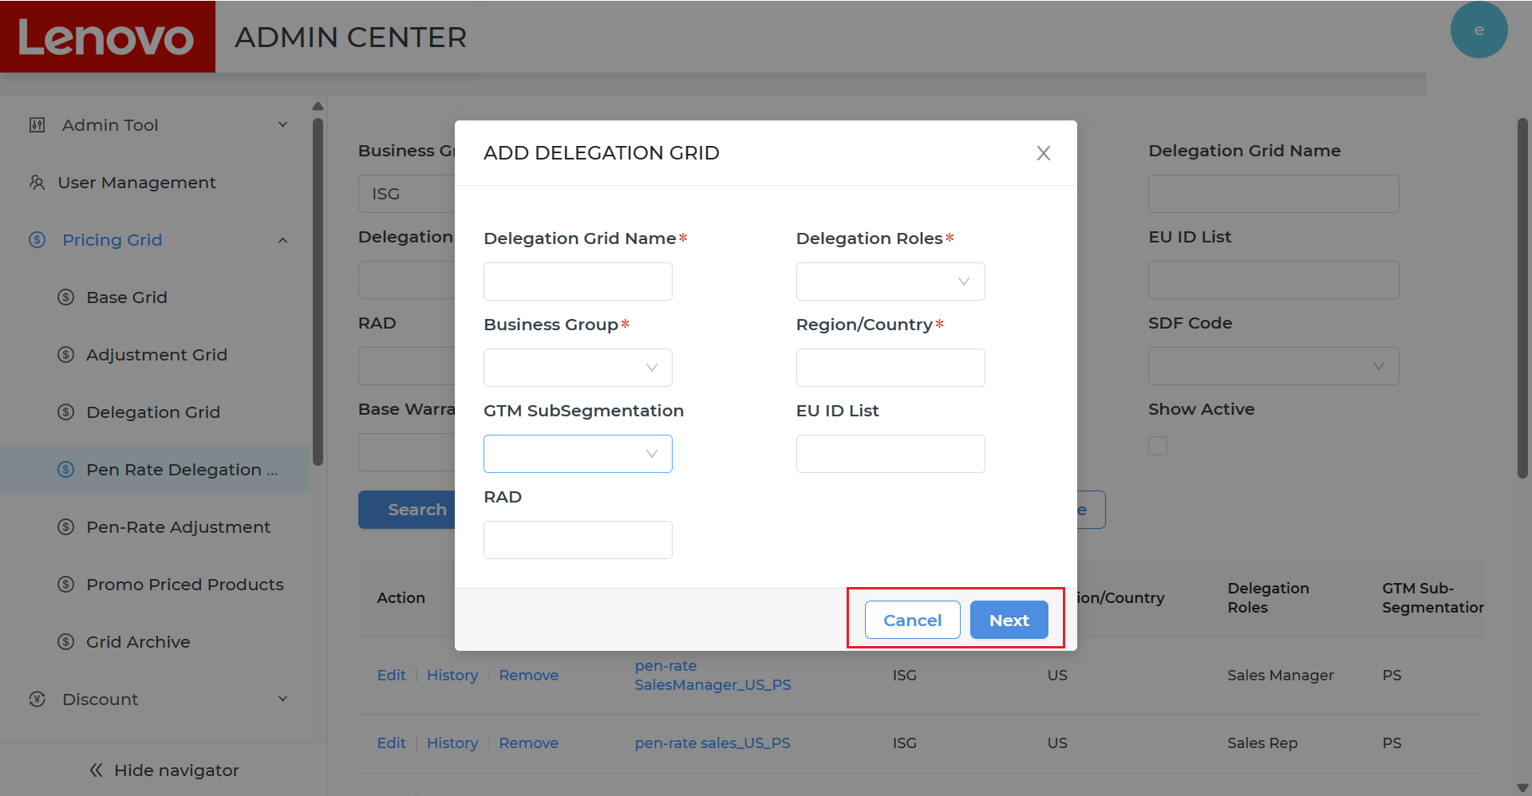
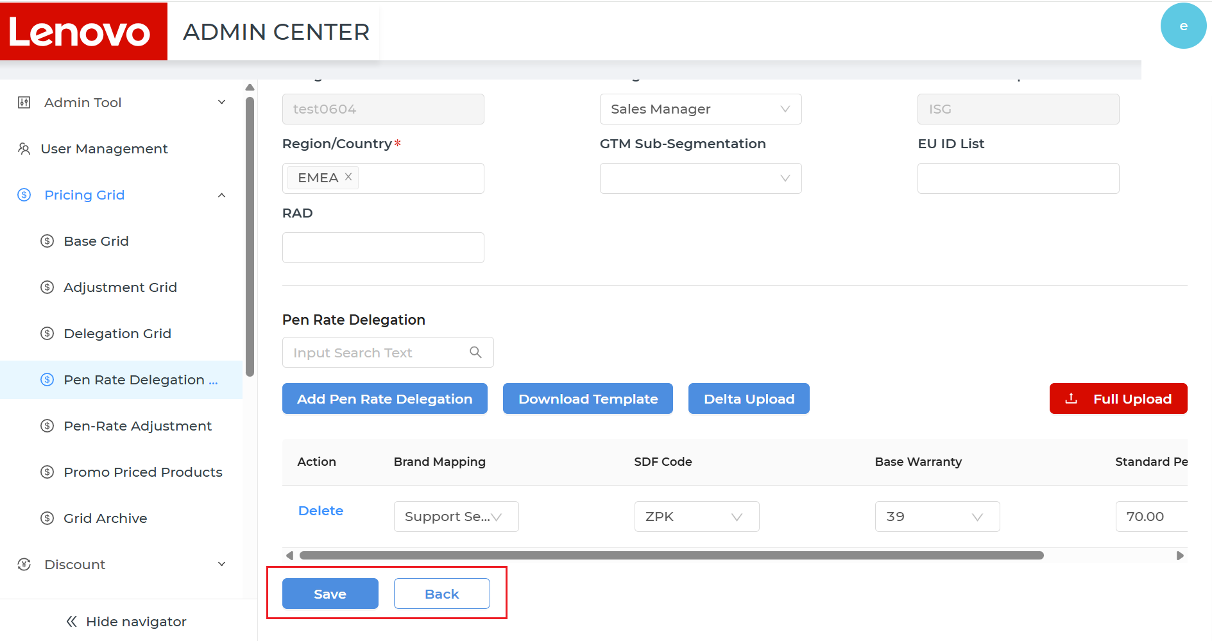
# | Story Number | Key Delivery
1 | DYPC2-3 | Need new Pen-Rate delegation table in Admin Center
6
Click <Add> button, user can create delegations.
User can fill the basic information in the <Add Delegation Grid> pop-up. Click <Cancel> button, nothing will be saved and it will go back to the delegation list page. Click <OK> button, it will go to the delegation detail page.
7
User can fill header and Pen Rate Delegation information on the delegation detail page.
Click <Add Pen Rate Delegation> button, user can add several lines.
Click <Download Template> button, user can download the Template to upload the file.
Click <Delta Upload> button, user can delta upload the delegation information.
Click <Full Upload> button, user can full upload the delegation information.
Click the <Delete> button on the line, user can delete the line.
Click <Save> button, all the information will be saved, and it will go back to the delegation list page.
Click <Back> button, nothing will be saved, and it will go back to the delegation list page.

Slide 11
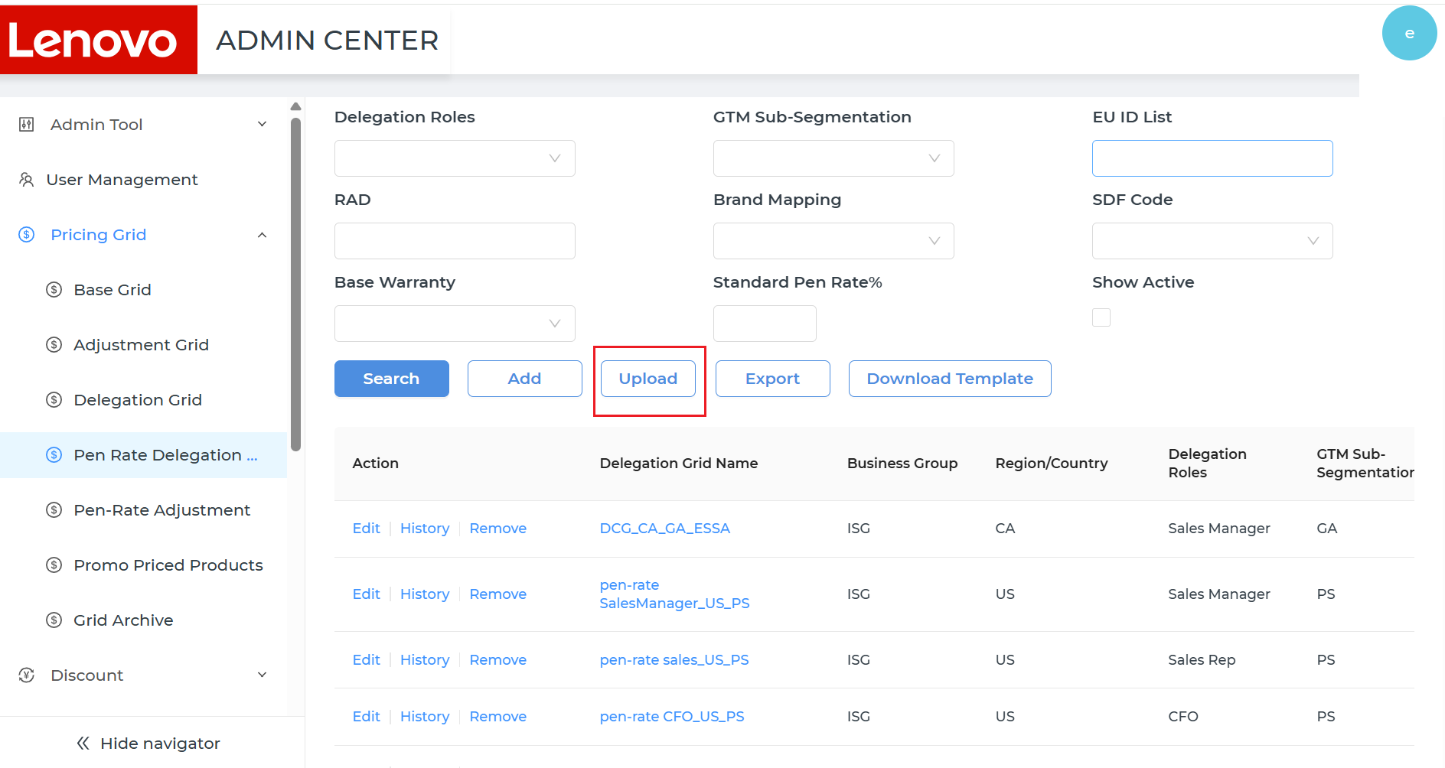
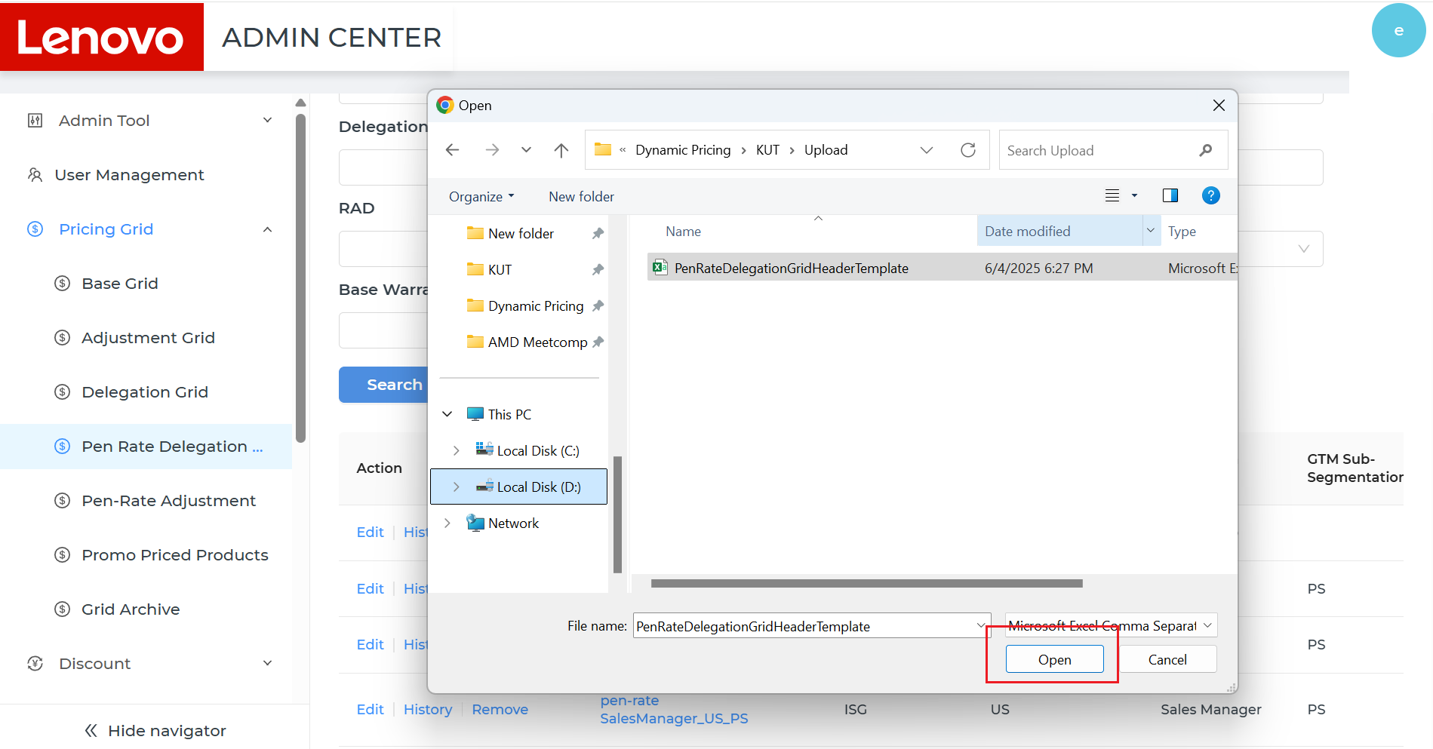
# | Story Number | Key Delivery
1 | DYPC2-3 | Need new Pen-Rate delegation table in Admin Center
8
Click the <Upload> button, user can upload the delegation information.
Click <Upload> button, there will be a pop-up, select the file need to be uploaded, click the <Open> button, the file will be uploaded once all the validations are passed, click the <Cancel> button, nothing will be changed and it will go back to the delegation list page.

Slide 12
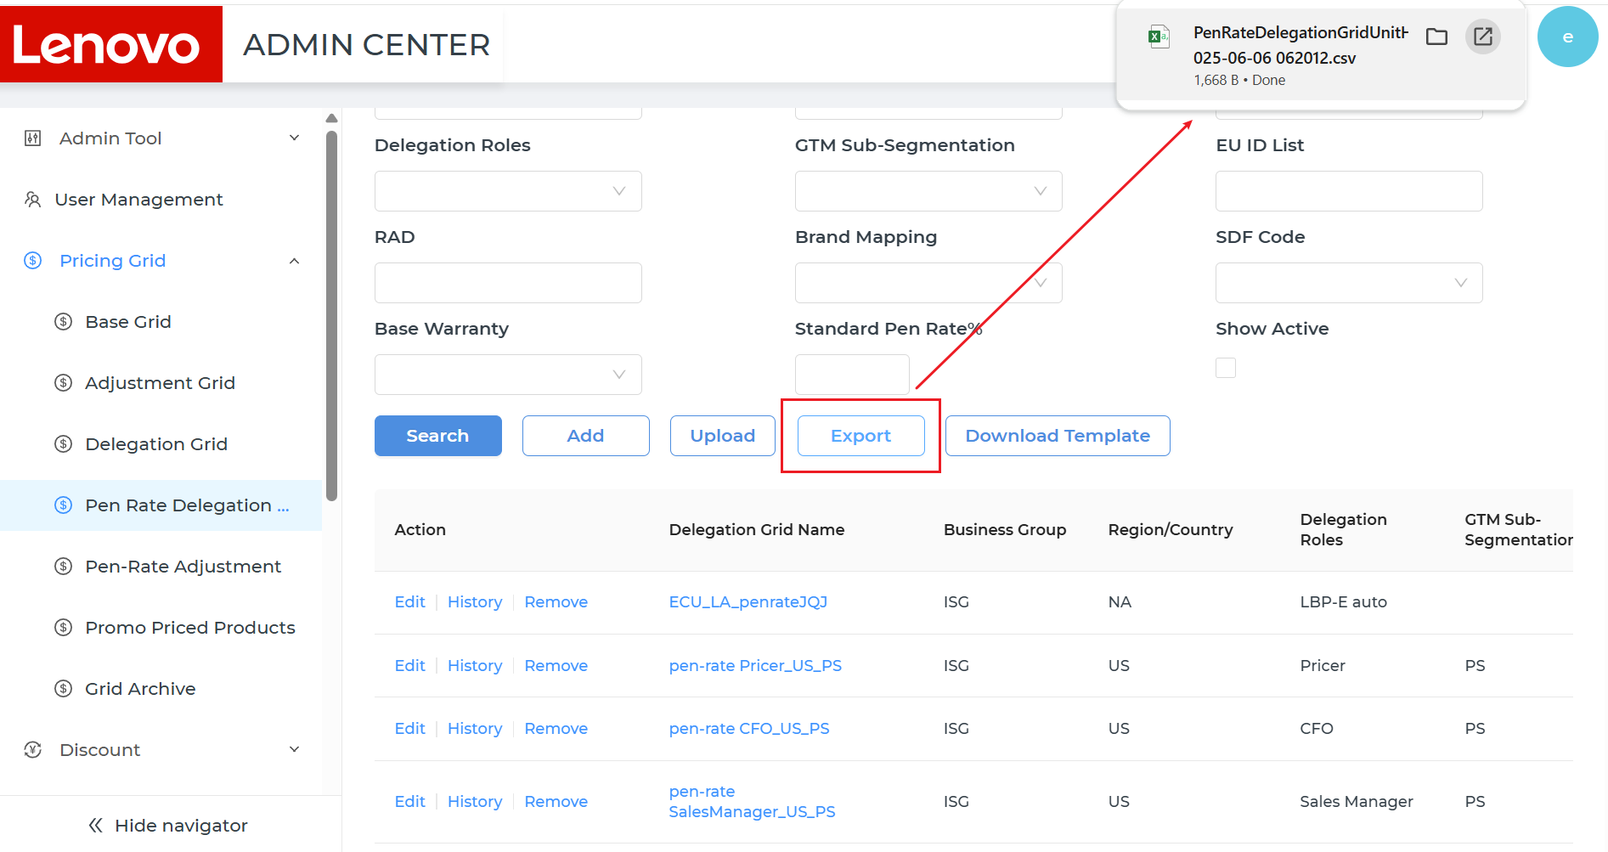
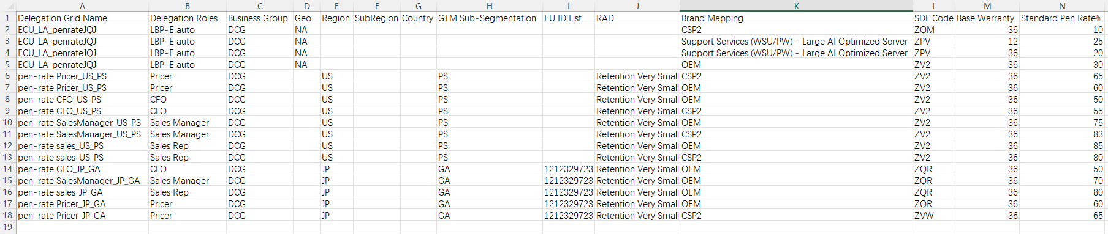
# | Story Number | Key Delivery
1 | DYPC2-3 | Need new Pen-Rate delegation table in Admin Center
9
Click the <Export> button, user can export the delegation information.
Click <Export> button, a file can be exported for checking.

Slide 13
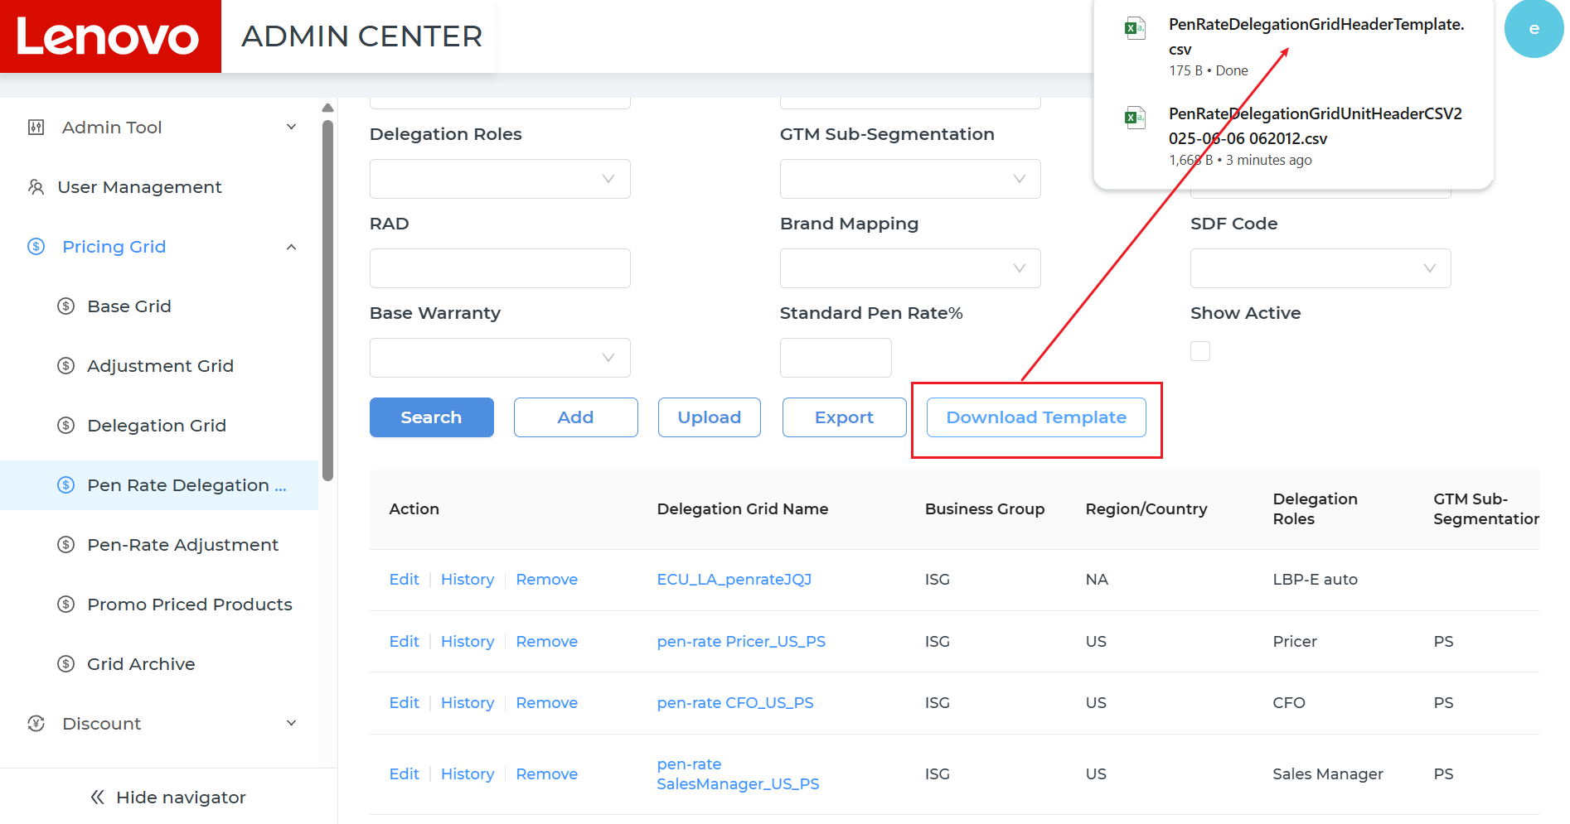
# | Story Number | Key Delivery
1 | DYPC2-3 | Need new Pen-Rate delegation table in Admin Center
10
Click the <Download Template> button, user can download the template for uploading.

Slide 14
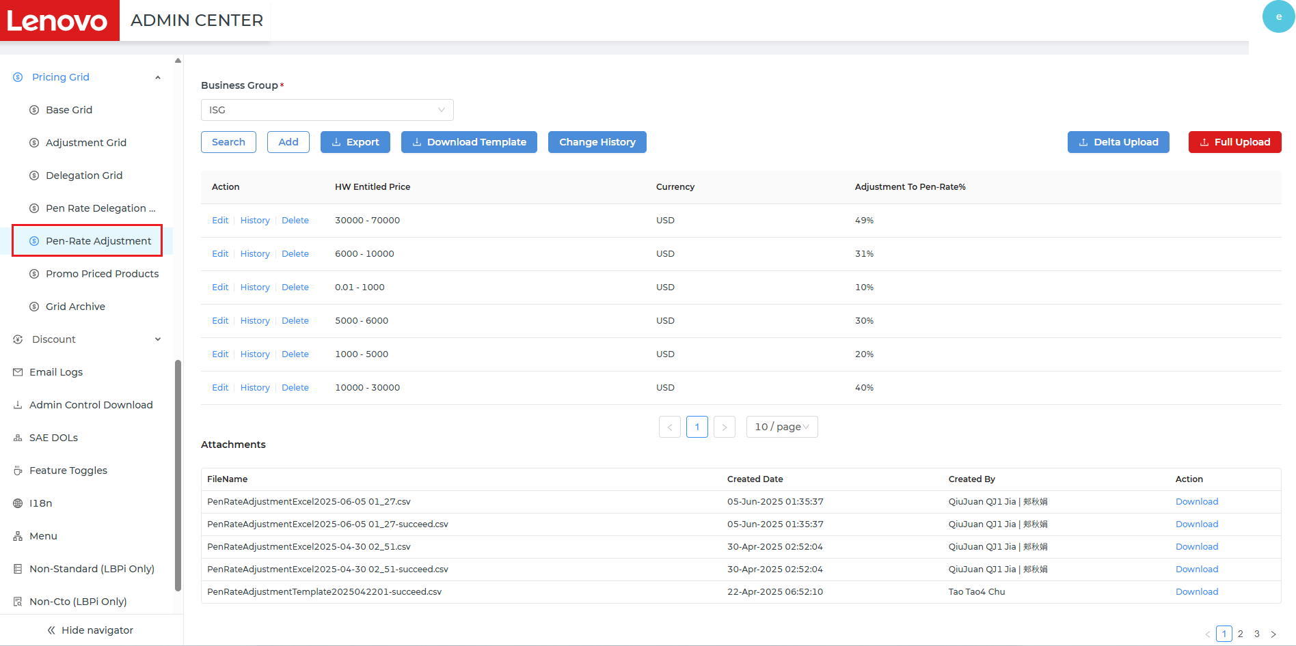
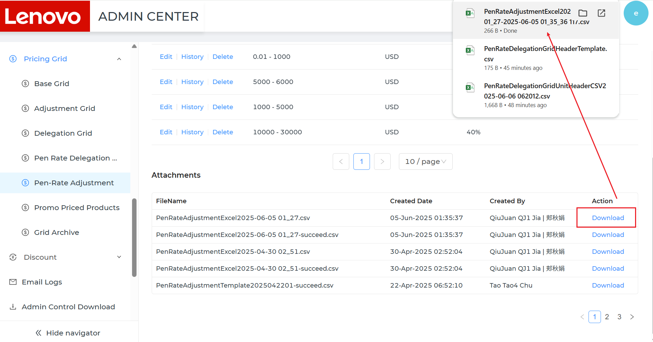
# | Story Number | Key Delivery
2 | DYPC2-4 | Need new Pen-Rate Adjustment table in Admin Center
1
Open LBP Admin, click Pricing Grid-Pen Rate Adjustment table, user can check Pen Rate Adjustment information.
User can check the Adjustment To Pen-Rate% list on the page.
User can check the upload files in the Attachment area, click <Download> button on the line, user can download the files.

Slide 15
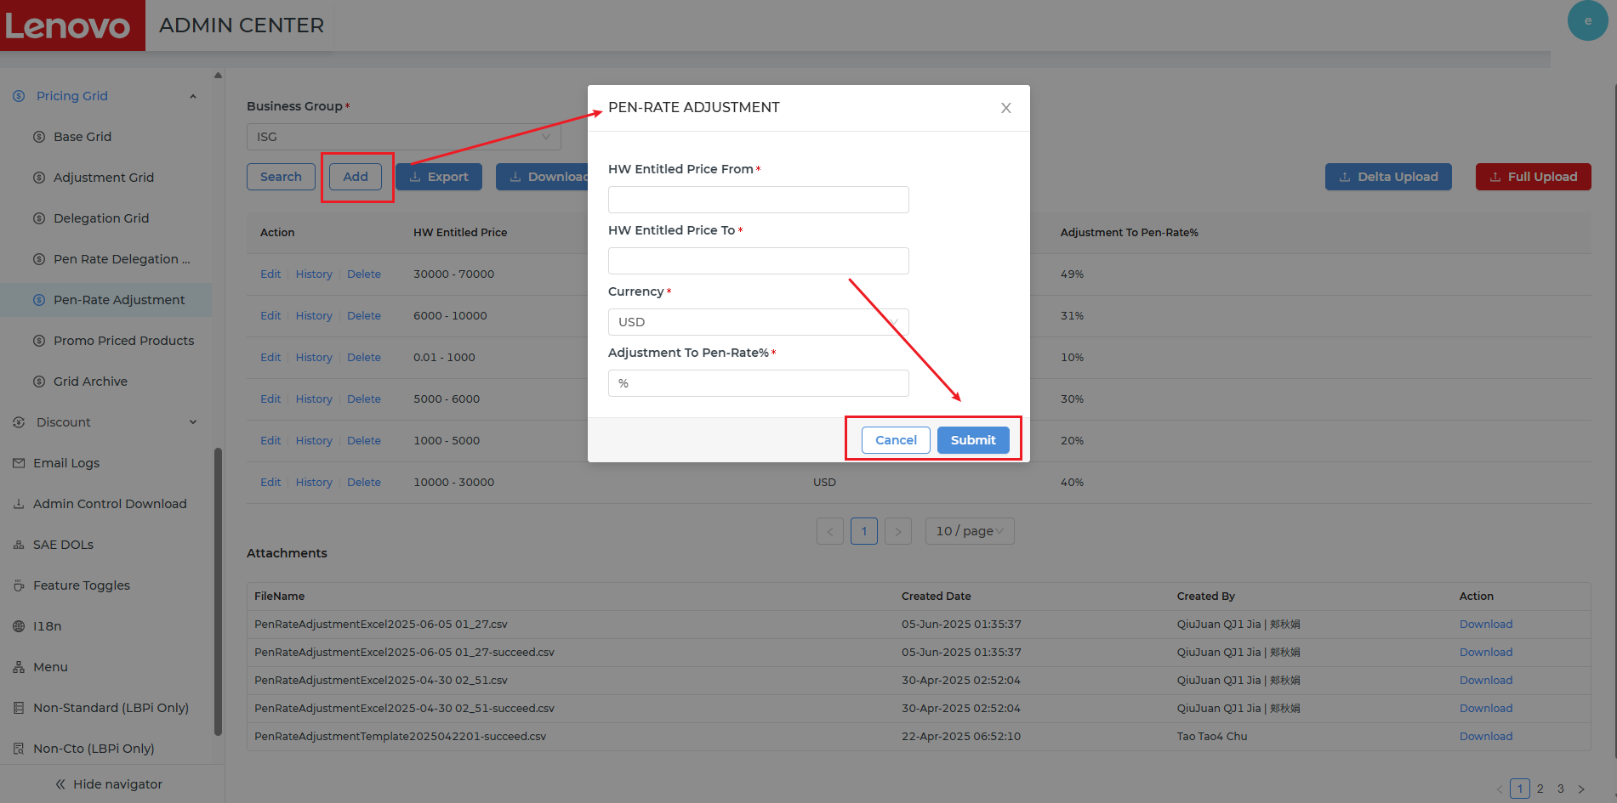
# | Story Number | Key Delivery
2 | DYPC2-4 | Need new Pen-Rate Adjustment table in Admin Center
2
Click <Add> button, user can create Pen-Rate Adjustment records.
User can fill the information in the <Pen-Rate Adjustment> pop-up. Click <Cancel> button, nothing will be saved and it will go back to the Adjustment list page. Click <Submit> button, the records will be saved if all the validations are passed.

Slide 16
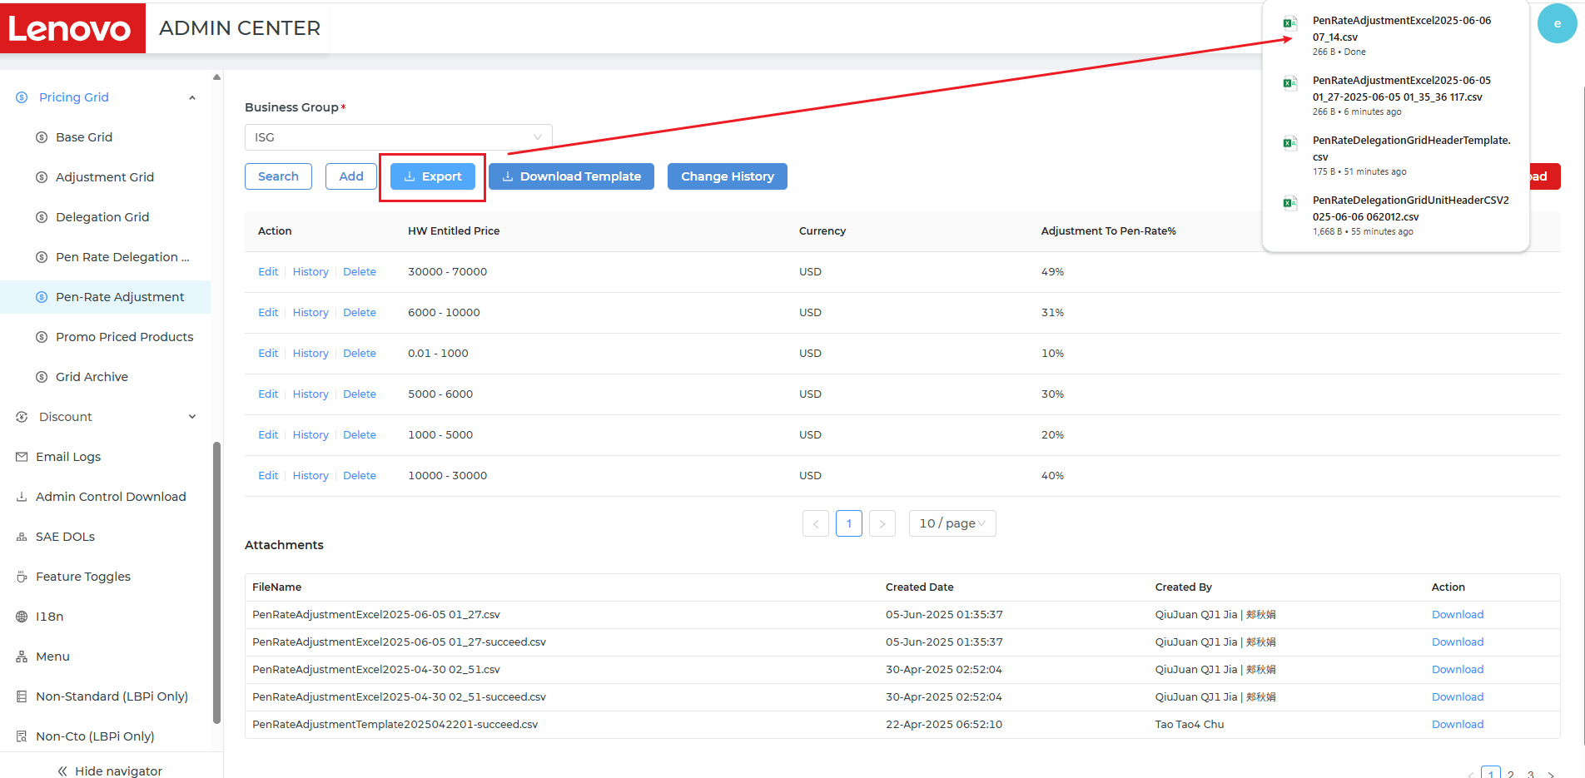
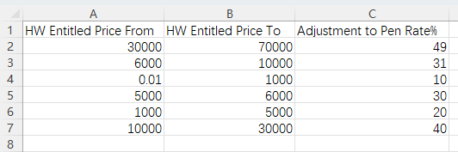
# | Story Number | Key Delivery
2 | DYPC2-4 | Need new Pen-Rate Adjustment table in Admin Center
3
Click the <Export> button, user can export the delegation info.
Click <Export> button, a file can be exported for checking.

Slide 17
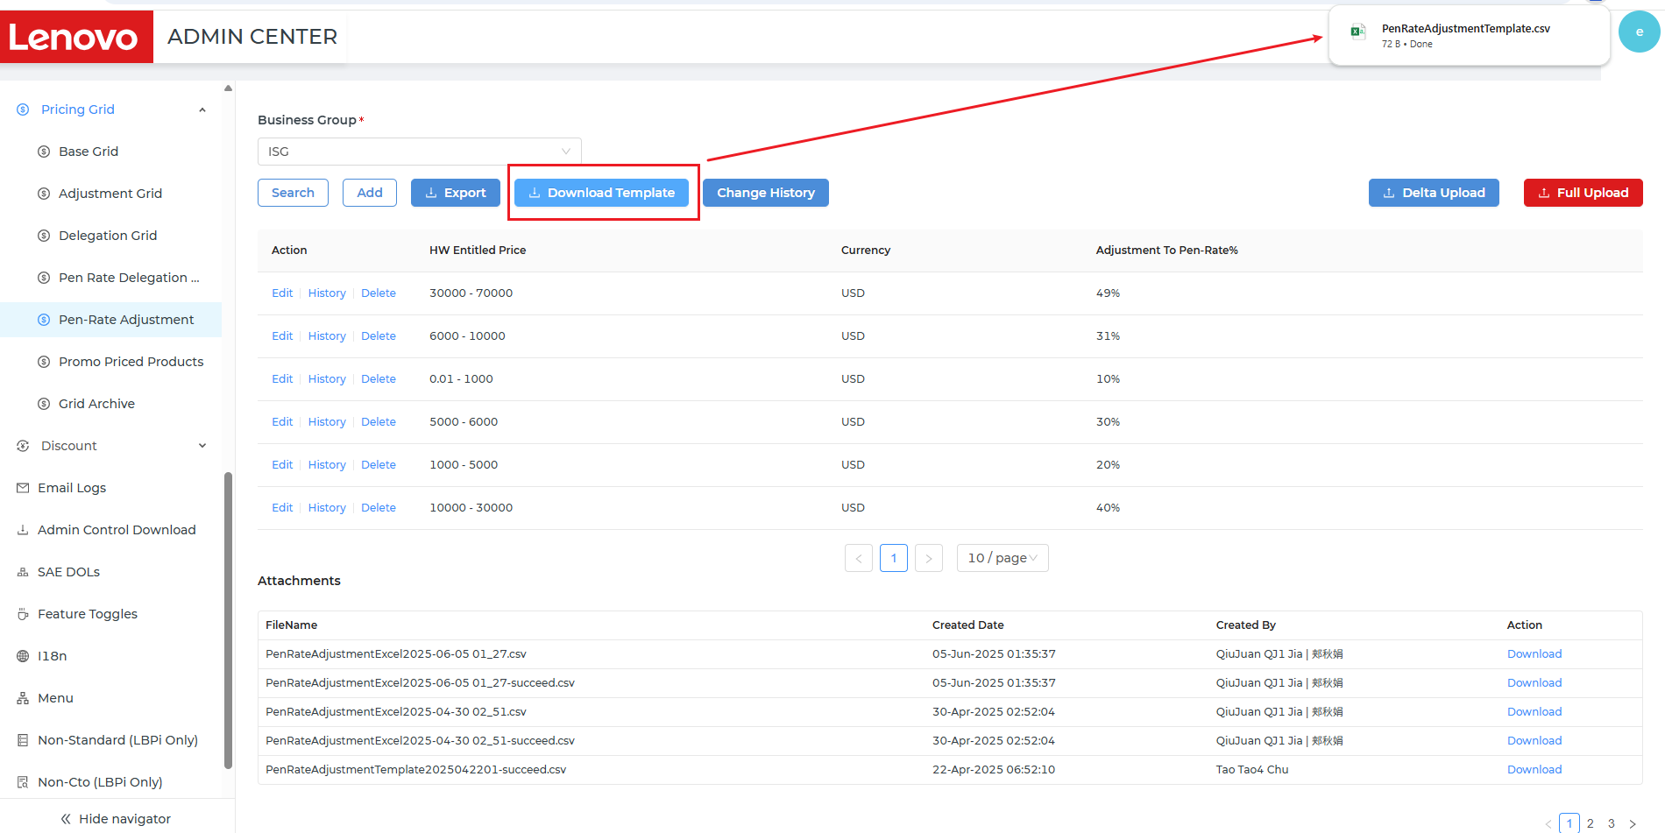
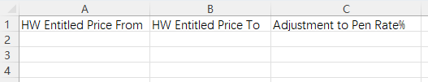
# | Story Number | Key Delivery
2 | DYPC2-4 | Need new Pen-Rate Adjustment table in Admin Center
4
Click the <Download Template> button, user can download the template for uploading.

Slide 18
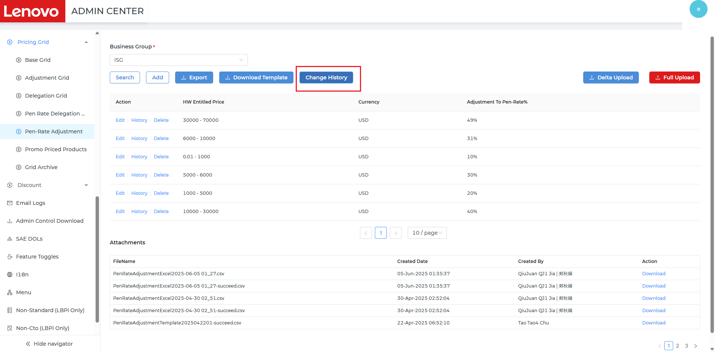
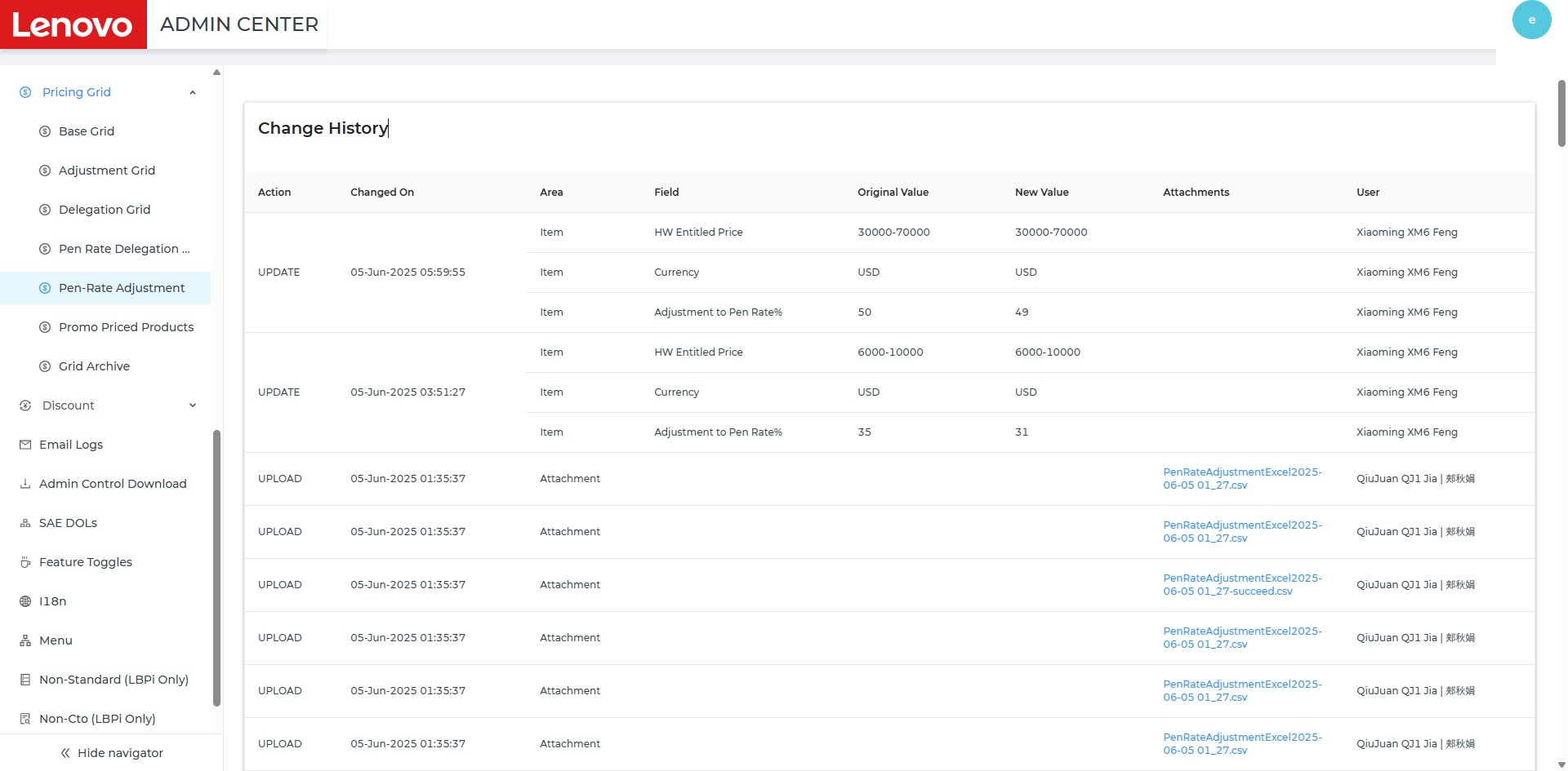
# | Story Number | Key Delivery
2 | DYPC2-4 | Need new Pen-Rate Adjustment table in Admin Center
5
Click <Change History> button on the line, it will jump to the history detail page, user can check the history of the Adjustment.
User can check the history by pages.
Click the hyperlink under the <Attachment> column, user can check the file details.
Click<Back> button, it will go back to the Adjustment list page.

Slide 19
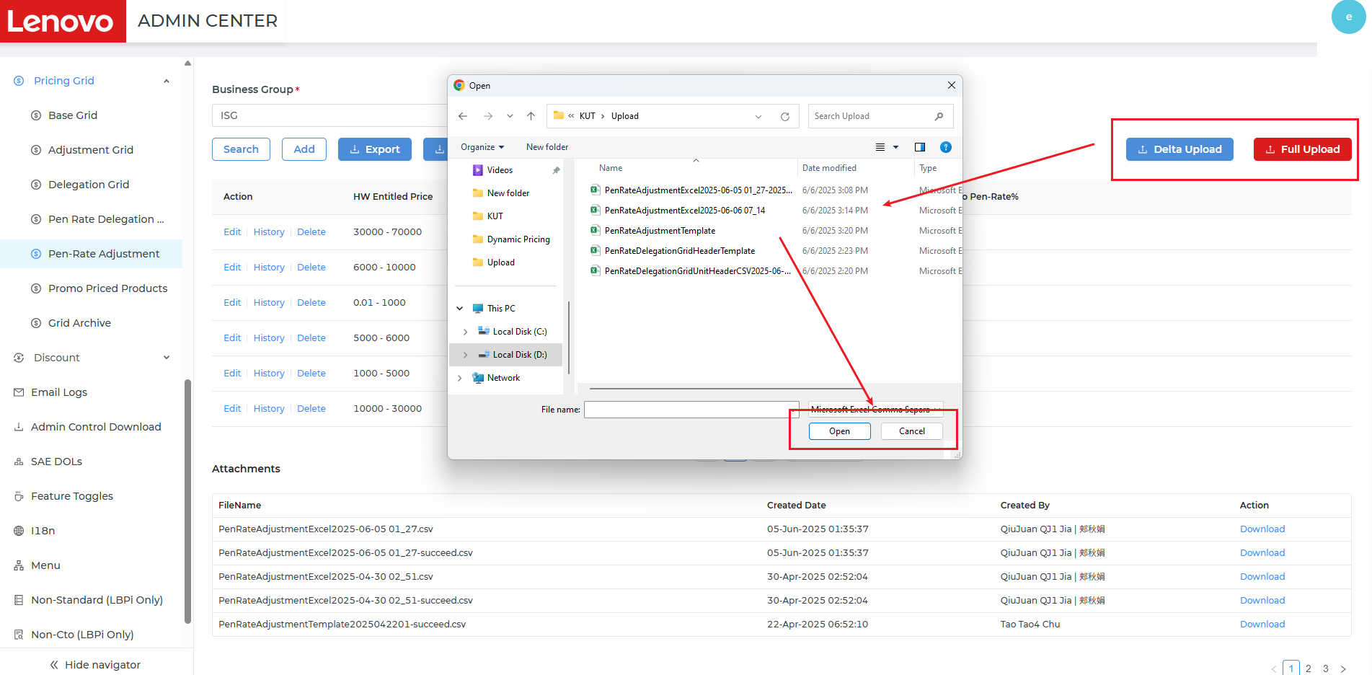
# | Story Number | Key Delivery
2 | DYPC2-4 | Need new Pen-Rate Adjustment table in Admin Center
6
User enable to Delta Upload/Full upload the Adjustment records.
Click <Delta Upload> button, user can delta upload the Adjustment information.
Click <Full Upload> button, user can full upload the Adjustment information.

Slide 20
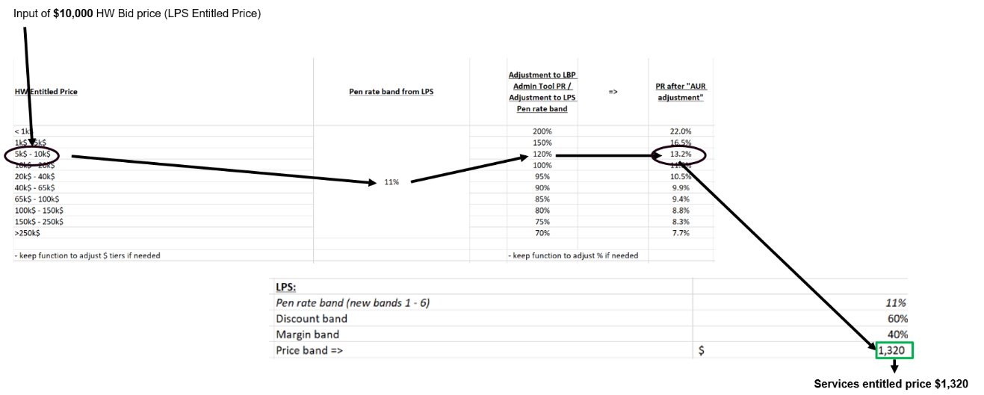
# | Story Number | Key Delivery
3 | DYPC2-5 | Need Pen-Rate Priority Logic
Map the value of the 5 field between the field maintained in Pen Rate table and the field in quote.
When determine the Final Delegation, system will do the field mapping first.
Use the Branding Mapping as the bridge to map the PN and PC :​
① Find the PN in quote.​
② Use the PN to map PN maintained in Brand Mapping table.​
③ Use the PN's Branding find in Brand Mapping table to map with the Brand Mapping field in Pen Rate Delegation table.​
④ Use PN to map in priority, if PN is not mapped, use PC to do the mapping, follow the step ①-③ to do the mapping.​
Priority:​ BU ＞ Country ＞ EU ID list ＞ GTM sub-segmentation ＞ RAD​
1
Parameter​ | Mapping Approach​
Brand Mapping​ | The PC/PN of the Brand maintained in Pen Rate Delegation table is mapped with the Service PN's PC OR PN in quote exactly​
SDF code​ | The value of SDF code maintained in Pen Rate Delegation table is mapped with the Service PN's SDF code in quote exactly​
Base Warranty​ | The value of Base Warranty maintained in Pen Rate Delegation table is mapped with the HW's Base Warranty in quote exactly​
RAD​ | The value of Rad maintained in Pen Rate Delegation table is mapped with the Rad in quote exactly​
GTM Sub-Segmentation​ | The value of GTM Sub-Segmentation maintained in Pen Rate Delegation table is mapped with the GTM Sub-Segmentation in quote exactly​
2
System will calculate the Adjustment Pen Rate value
Calculate the Adjustment Pen Rate value: Adjusted Pen Rate = Standard Pen Rate * Adjustment to Pen-Rate% ​
Use the HW's Unit Sales Price to find the Adjustment to Pen-Rate% value
E.g. ​
Once the = HW's Unit Sales Price=$9,000, the standard Pen rate maintained in the Pen Rate Delegation table=11%, the Adjustment to Pen-Rate%=120%, ​
Then : Adjusted Pen Rate = 11% * 120%=13.2%

Slide 21
# | Story Number | Key Delivery
3 | DYPC2-5 | Need Pen-Rate Priority Logic
3
System will calculate the Pen Rate Delegation.
Calculate the Pen Rate Delegation Price: Pen Rate Delegation = HW's Unit Sales Price* Adjusted Pen Rate.​
E.g. ​
Once the = HW's Unit Sales Price=$9,000, the standard Pen rate maintained in the Pen Rate Delegation table=11%, the Adjustment to Pen-Rate%=120%, Adjusted Pen Rate = 11% * 120%=13.2%​
Then: Pen Rate Delegation Price= 9,000*13.2%=1188​

Slide 22
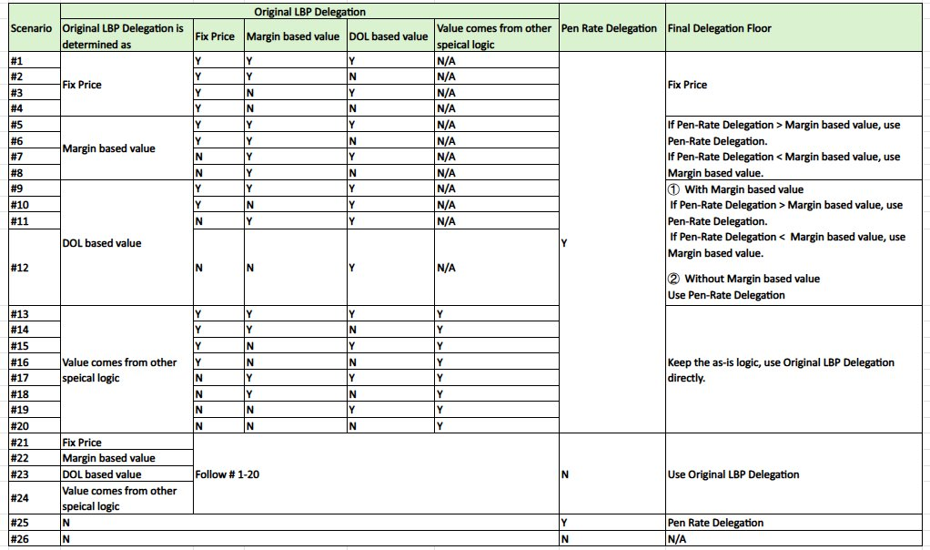
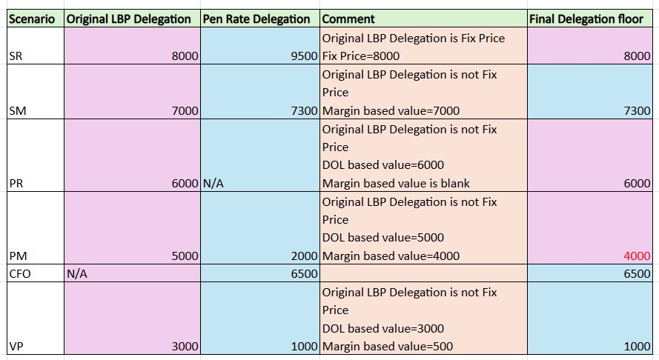
# | Story Number | Key Delivery
3 | DYPC2-5 | Need Pen-Rate Priority Logic
4
Compare Original LBP Delegation and Pen Rate Delegation
Compare Original LBP Delegation and Pen Rate Delegation and then determine the Final Delegation Floor based on the table on the left.
E.g. ​

Slide 23
# | Story Number | Key Delivery
3 | DYPC2-5 | Need Pen-Rate Priority Logic
Note:
Can use the file for reference to check the delegation value during the testing.
Dynamic Pricing Phase 2- Testing Reference.xlsx

Slide 24
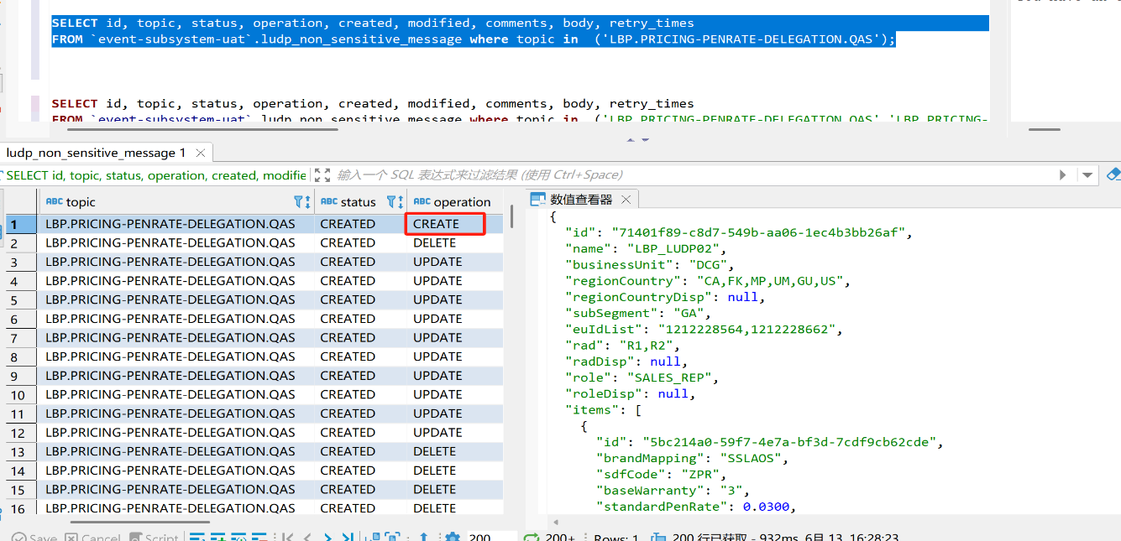
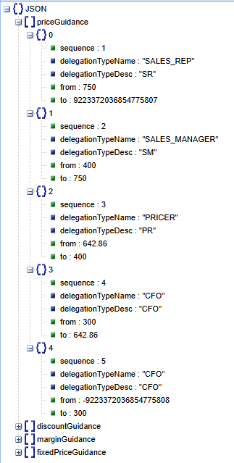

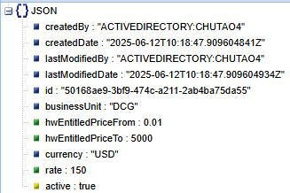
# | Story Number | Key Delivery
4 | DYPC2-12 | Pass Pen Rate information to LUDP/Magellan
1
LBP has passed all the Pen Rate related information to LUDP.
LBP has passed information involved in Pen Rate Delegation table to LUDP.
LBP has passed information involved in Pen-Rate Adjustment table to LUDP.
LBP has passed Base Warranty/SDF code/Final Delegation with the PN information to LUDP.

Slide 25
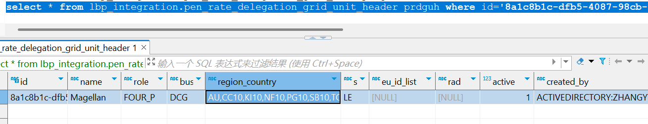
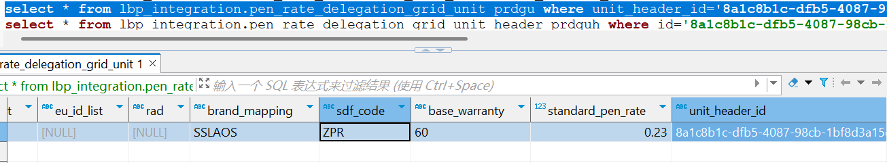
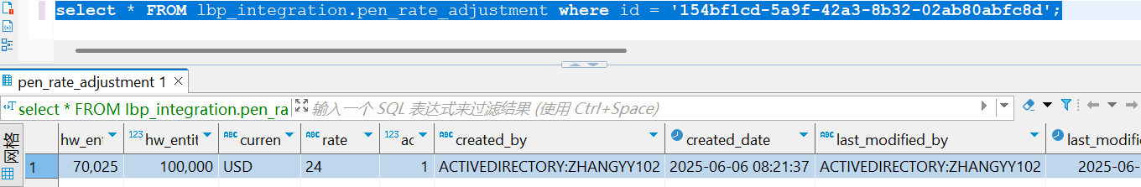
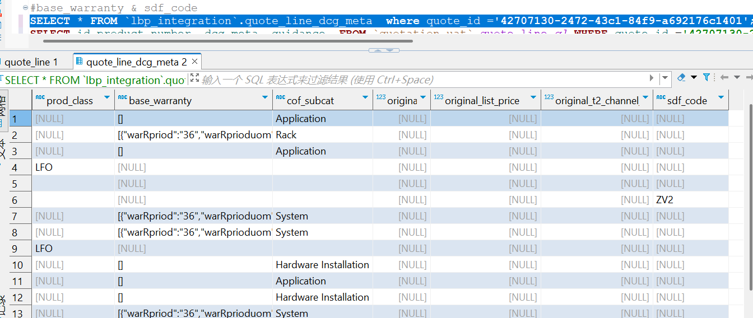
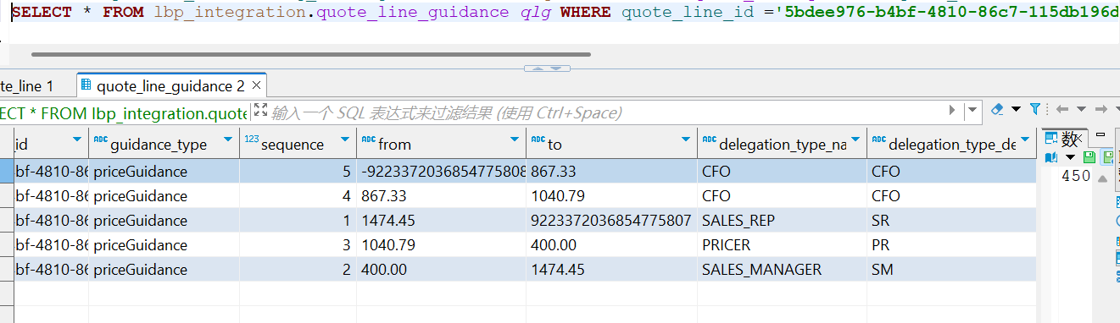
# | Story Number | Key Delivery
4 | DYPC2-12 | Pass Pen Rate information to LUDP/Magellan
2
LBP has passed all the Pen Rate related information to Magellan.
LBP has passed information involved in Pen Rate Delegation table to Magellan.
LBP has passed information involved in Pen-Rate Adjustment table to Magellan.
LBP has passed Base Warranty/SDF code/Final Delegation with the PN information to Magellan.

Slide 26
Questions

